Slide 1
PLD - PAL - PLA

Slide 2
A programmable logic device (PLD) is an electronic component used to build reconfigurable digital circuits. Unlike integrated circuits (IC) which consist of logic gates and have a fixed function, a PLD has an undefined function at the time of manufacture.

Slide 3
What is the main application of PLDs?
They are programmable electronic components that can be used to build digital circuits. The complete family is called PLD (Programmable Logic Device). Their main use is to minimize the amount of digital integrated circuits required for a certain application, and thus lower the cost and size of a board.

Slide 4
What do you mean by programmable device?
Any device whose operation is controlled by a stored program that can be changed or replaced.

Slide 5
What are programmable logic devices used for?
A PLD, or programmable logic device, is an electronic component that is used in order to build digital circuits that are reprogrammable. A programmable logic device does not have a defined function once manufactured, unlike a logic gate and has to be programmed before it can be used.

Slide 6
What is the main application of PLDs?
They are programmable electronic components that can be used to build digital circuits. The complete family is called PLD (Programmable Logic Device). Their main use is to minimize the amount of digital integrated circuits required for a certain application, and thus lower the cost and size of a board.

Slide 7
How PLDs are programmed?
There are three kinds of PLDs based on the type of arrays, which has programmable feature. The process of entering the information into these devices is known as programming. Basically, users can program these devices or ICs electrically in order to implement the Boolean functions based on the requirement.

Slide 8
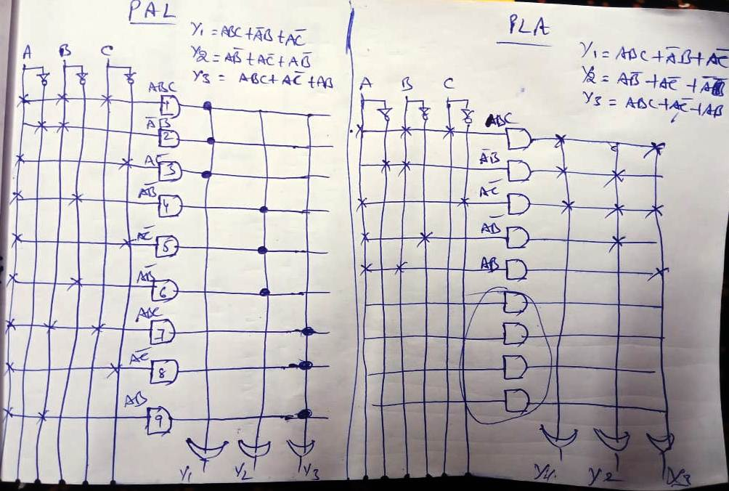

Slide 9
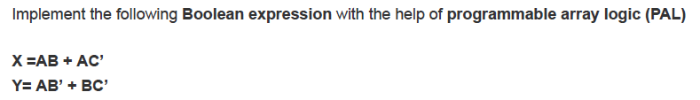

Slide 10


Slide 11
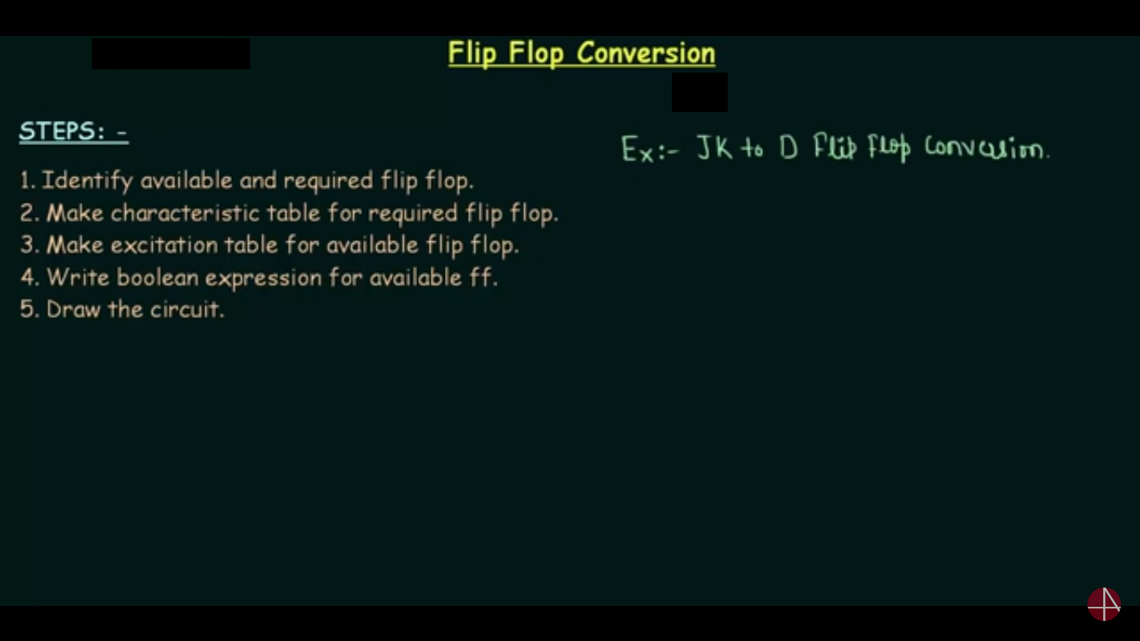

Slide 12
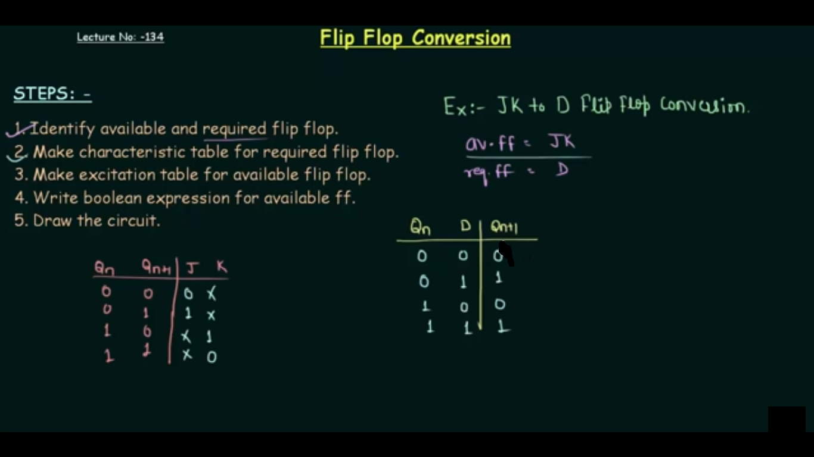

Slide 13
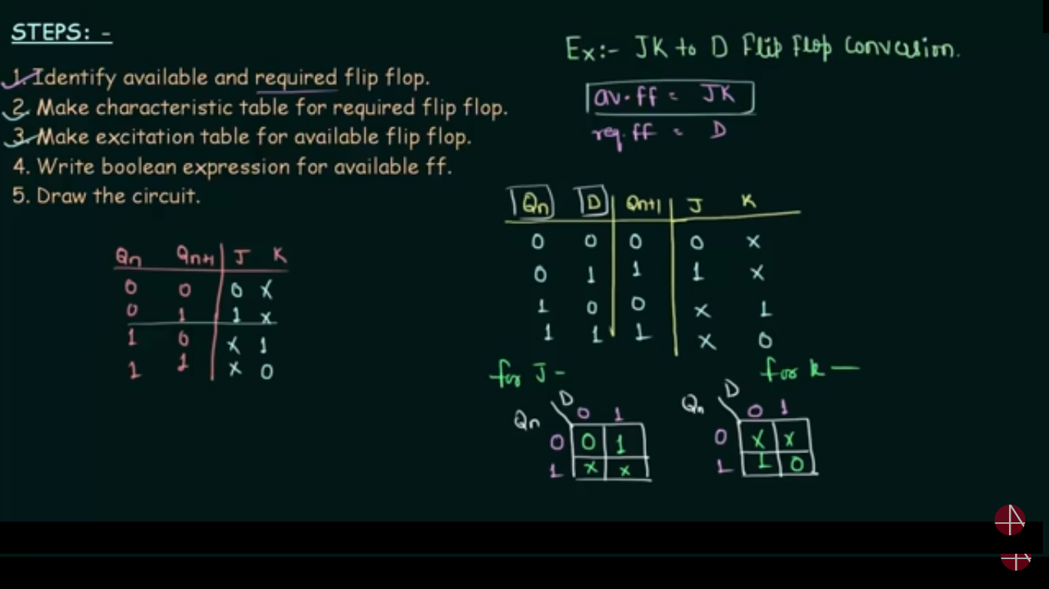

Slide 14
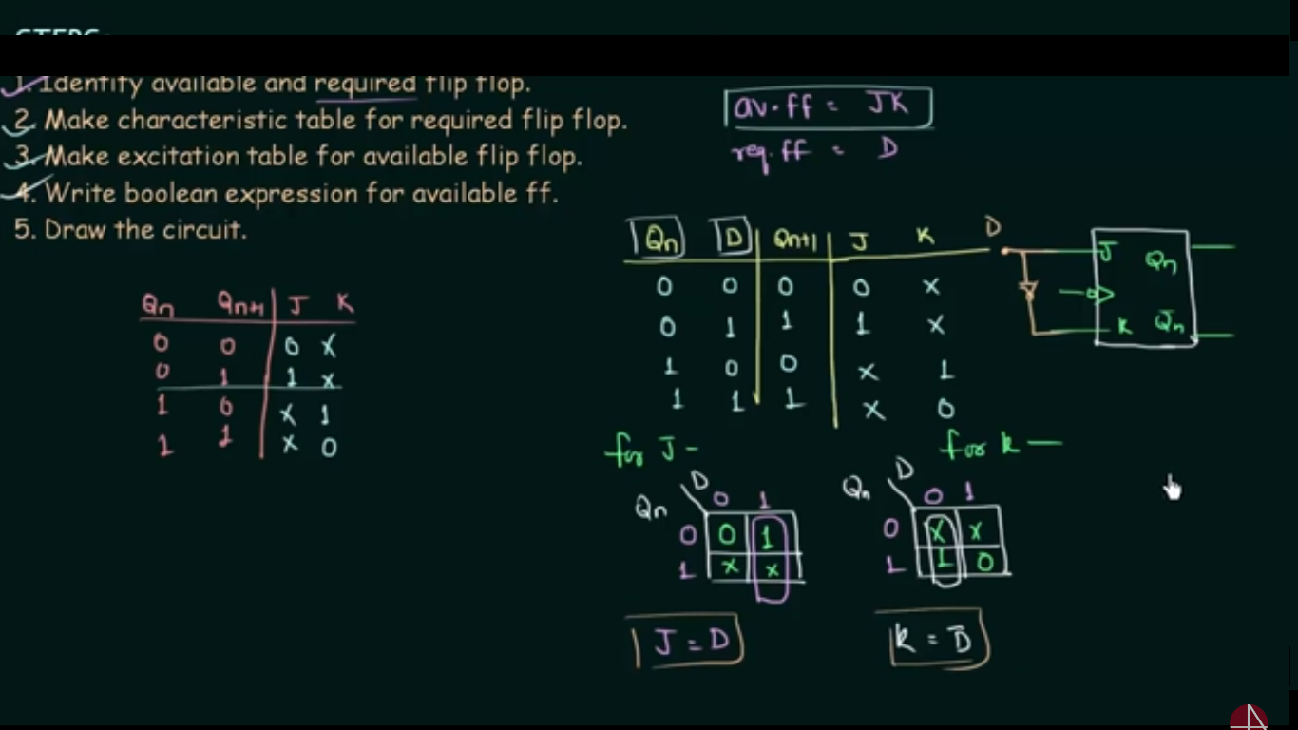

Slide 15
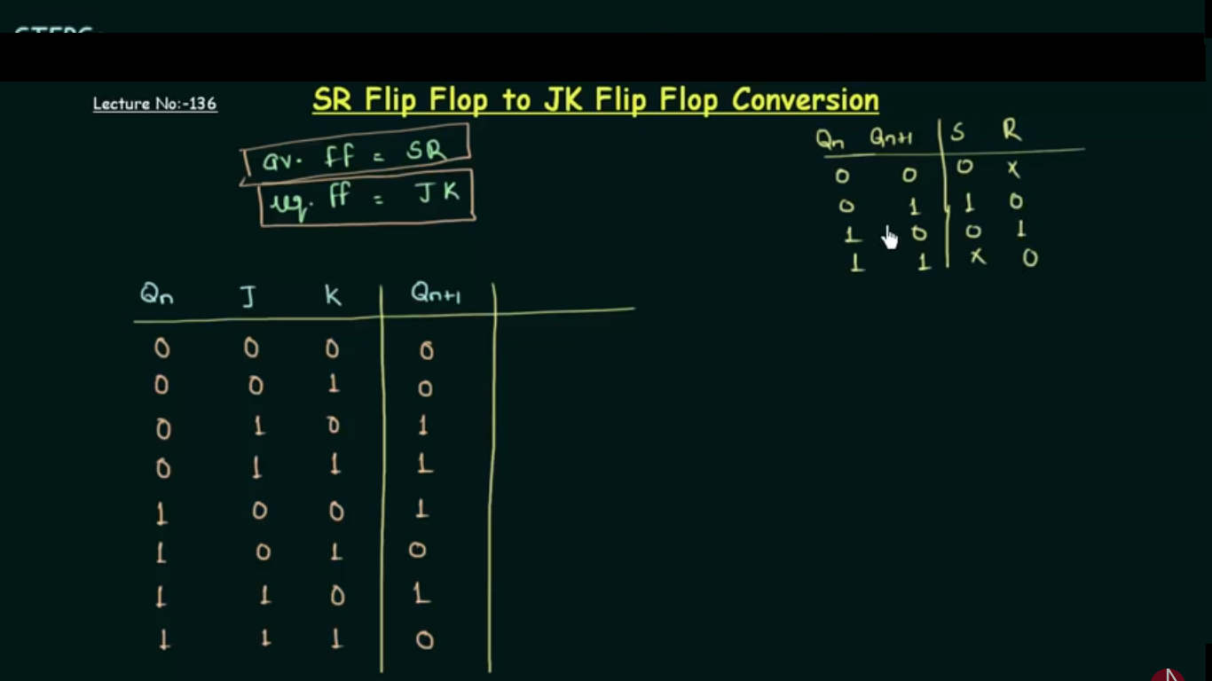

Slide 16
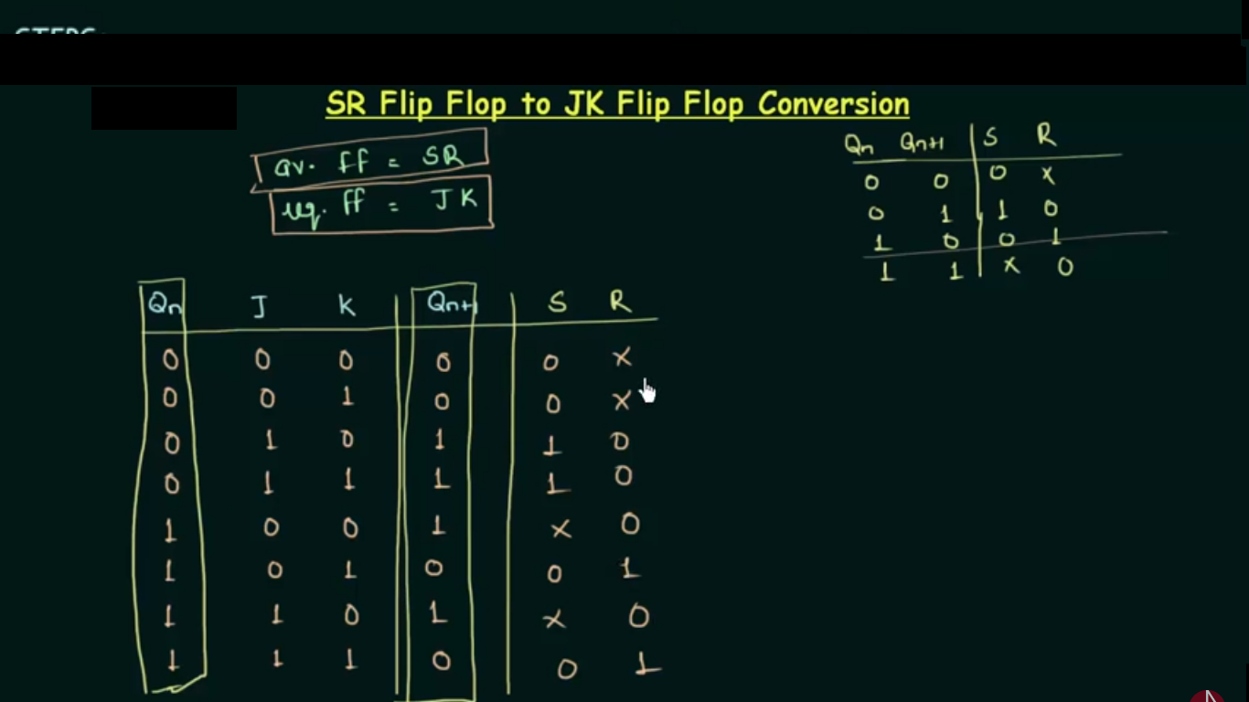

Slide 17
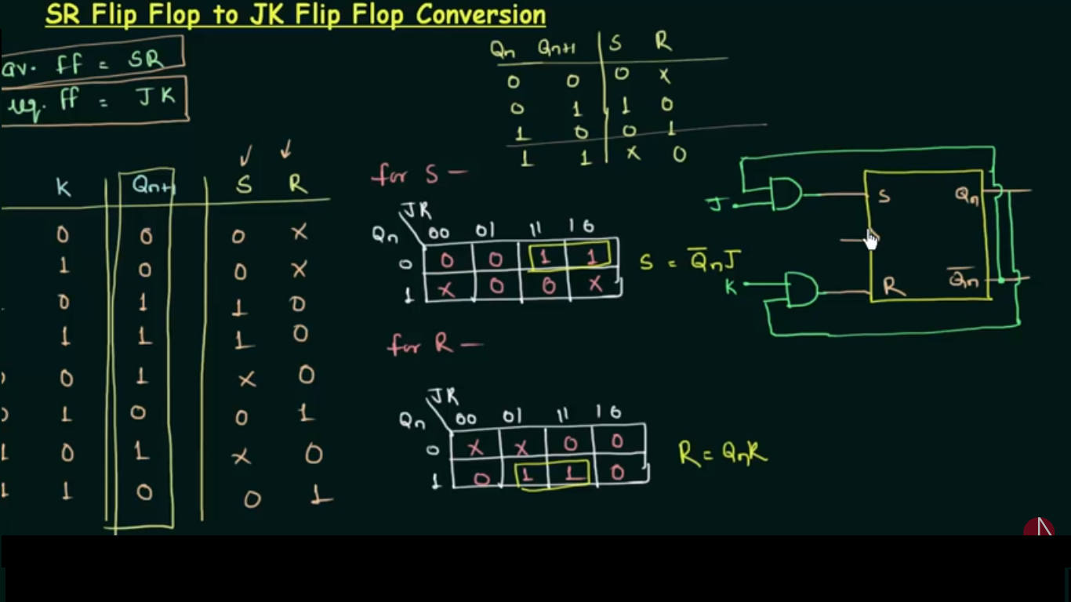

Slide 18
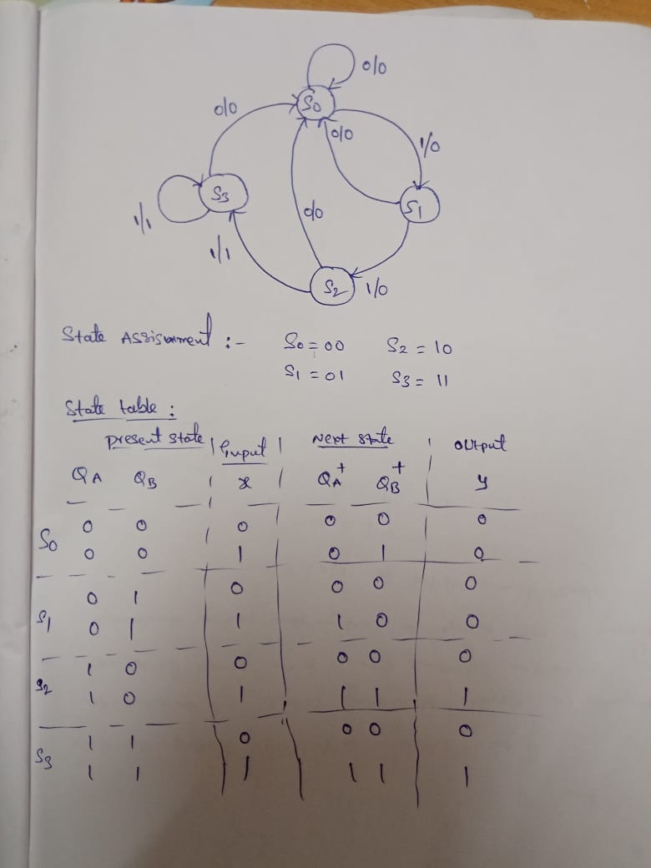
Design the logic diagram for the state diagram shown below

Slide 19
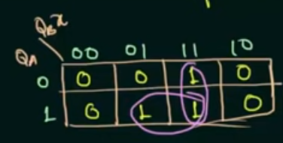


Slide 20
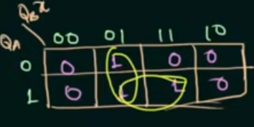


Slide 21
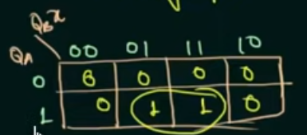


Slide 22
